Slide 1
GNSS Positioning Algorithms
Practical Works
November 2026
Paul Thevenon, ENAC
Jan Bolting, SwiftNav

Slide 2
Positioning Algorithm
Intermediate Frequency Samples
Code obs
Carrier obs
Doppler obs
Navigation data bits
Position, Velocity, Timing
RF
Front-end
Baseband Signal Processing
Navigation Algorithm

Slide 3
Positioning Algorithm
Intermediate Frequency Samples
Code obs
Carrier obs
Doppler obs
Navigation data bits
Position, Velocity, Timing
RF
Front-end
Baseband Signal Processing
Navigation Algorithm
RINEX file
GNSS raw data
code
carrier phase
Doppler
C/N0
….
RINEX OBS file
RINEX
NAV file
GNSS Navigation message
Kepler parameters
satellite clock
satellite hardware bias
ionospheric correction
…

Slide 4
Positioning Algorithm
Code obs
Carrier obs
Doppler obs
Navigation data bits
Navigation Algorithm
Position, Velocity, Timing
RINEX OBS file
Satellite position and clock
time of emission
relativistic effect
sagnac effect (Earth rotation)
Observation corrections
satellite hardware bias
iono
tropo
Weighted Least Squares estimation
Jacobian computation
Observation prediction
RINEX
NAV file

Slide 5
Positioning Algorithm
Code obs
Carrier obs
Doppler obs
Navigation data bits
Navigation Algorithm
Position, Velocity, Timing
RINEX OBS file
PRX
Satellite position and clock
time of emission
relativistic effect
sagnac effect (Earth rotation)
Observation corrections
satellite hardware bias
iono
tropo
Weighted Least Squares estimation
Jacobian computation
Observation prediction
PRX CSV file
RINEX
NAV file

Slide 6


Practical works outline
Focus on the use of polars, a “Blazingly Fast DataFrame Library”
  Datascience library for processing structure data
  Widely used in research and industry
  Core is written in Rust, which explains its speed
  Open source, 40.2K github stars (as of Oct 2026)
Process real data from the IGS (International GNSS Service) data
  TLSE station, hosted in CNES
  24 hours at 30 s interval on 2024-01-01

Slide 7
Practical works outline
  chapter_0_polars.md: discover polars
      tutorial Jupyter notebook
      select data
      apply functions
      plot
  chapter_1_spp.md: implement a Single Point Positioning solution
      implement observation model
      compute jacobian
      compute WLS
      analyze
  chapter_2_dgnss.md: implement a Differential GNSS solution
      apply differential corrections from a nearby base station
  chapter_3_rtk.md: implement a Real-Time Kinematics solution
      use differentially-corrected code and carrier observations
      Apply WLS over a batch of epochs (instead of a per epoch estimation)

Slide 8
Practical works outline
  Folder structure
    data/
    instructions_polars/
    src_polars/ <= code here!!
    tests_polars/
  Detailed instructions will guide you through the coding of the various required functions
    After each implementation, unit tests have been written
    You will check your implementation by running some command line such as:
# test_module.py
def test_add():
assert add(1,1)==2
assert add(1,-1)==0
# module.py
def add(a,b):
return …
#1 Already written
#3 You verify with
#2 You code here
# terminal
uv run pytest test_module.py::test_add

Slide 9
Practical works outline
  Use this powerpoint to put your answers and your results
  The final mark will depend on
    the number of passed tests
    the answers in this powerpoint
    the figures in this powerpoint

Slide 10
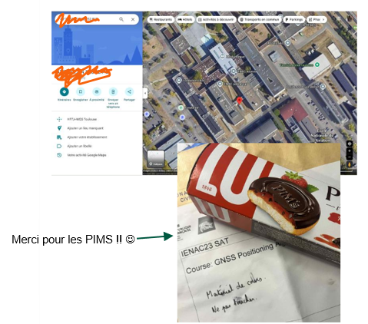
Practical works outline
Positioning accuracy leaderboard🏅
  A leaderboard will be updated with the accuracy of your best solution for each algorithm
Treasure hunt 💰
  We added a playful challenge that you can solve if you reach all the goals of the project.
  The folder “data/treasure_hunt” contains some particular GNSS observations.
    Each group will be attributed a specific file.
  Try to process them with your different positioning algorithms to unlock some coordinates and get your prize!!

Slide 11
Chapter 0: pandas

Slide 12
Misc questions
How many observations are there for GPS L1C signals from healthy satellites over 24 hours?
What is the min/max value of the iono delay?
Paste your figure generated by plot_nsat_vs_elevation_mask

Slide 13
Chapter 1: SPP

Slide 14
SPP solution
Paste your ENU error figure.
Include your score.
Comment the statistical description of the positioning error.

Slide 15
Improved SPP solution (optional)
Paste your ENU error figure for the improved SPP solution.
Include your score.
Comment the statistical description of the positioning error.
Why has it improved?

Slide 16
SPP - Treasure hunt
Paste your ENU error figure for SPP solution for the longitude of the treasure hunt

Slide 17
Chapter 2: DGNSS

Slide 18
DGNSS solution
Paste your ENU error figure.
Include your score.
Comment the statistical description of the positioning error.
Which errors were reduced by differential corrections?

Slide 19
DGNSS - Treasure hunt
Paste your ENU error figure for DGNSS solution for the longitude of the treasure hunt

Slide 20
Chapter 3: RTK

Slide 21
Cycle slips
How many cycle slips have been detected by the rover and base receivers?

Slide 22
Batch problem size
For a clean interval, what is the size of the problem:
  number of epochs in the selected interval,
  total number of observations,
  total number of states (position, clock, ambiguities).

Slide 23
RTK solution
Paste your ENU error figure.
Include your score.
Comment the statistical description of the positioning error.
What is the strongest assumption to be able to use this positioning algorithm?
Comment on the validity of such assumption for different classes of users: smartphones, automotive, aviation, geodesy

Slide 24
RTK - Treasure hunt
Paste your ENU error figure for RTK solution for the latitude of the treasure hunt

